Slide 1




SMART
POWER SUPPLY
SWITCH CONTROL
Sendilkumaran.S 190584B
Sajeethan.G 190540M
Mahiliny.J. 190378X
Kopikanth.K. 190320N

Slide 2
COMPONENTS IN THIS PROJECTS
Arduino UNO
Bluetooth Module (HC-06)
PIR Motion Detect Sensor Module (HC-SR501)
5VDC Relay Module
Ultrasonic Sensors (HC-SR04)
9V Batteries
HC-05 Controller Android Apps (You May Need...)

Slide 3




WHY THIS PROJECT?
NO NEED TO TOUCH SWITCHES.
IN THIS CORONA PANDEMIC SITUATION, THIS MAY HELP.
PREVENT SHOCKING.
SAVING POWER.
WE USE THE PIR SENSOR TO DETECT MOVEMENT FOR SWITCHING OFF ITSELF.
MANAGING ALL OF YOUR SWITCHES FROM ONE PLACE.
WHEN WE ABLE TO CONTROL ALL SWITCHES FROM MOBILE, IT HELPS TO SAVE SOME TIME WITH HOME AUTOMATION.
USER FRIENDLY.
IT IS NOT THAT MUCH OF HARD TO BE KNOWING ABOUT THE CONTROLS.
AND WE ARE PLANNING TO ADD SENSORS TO NOTIFY USER SOME TIPS.
EVEN MORE YOU CAN REALIZE…….
Notes:
Light switches are one of the highest touchpoints in the house and least clean. And it can easily keep virus and transfer while touching it . so this project can give you an alternate way to handling switches without touching it. Even there is no shocking hazard while turn switches on with moisture.
Mostly we are possible to forget that turn the lights off but now, here this PIR sensor is control where it conform there is no human activities then it’ll decide to turn off and save the most valuable power.

Slide 4
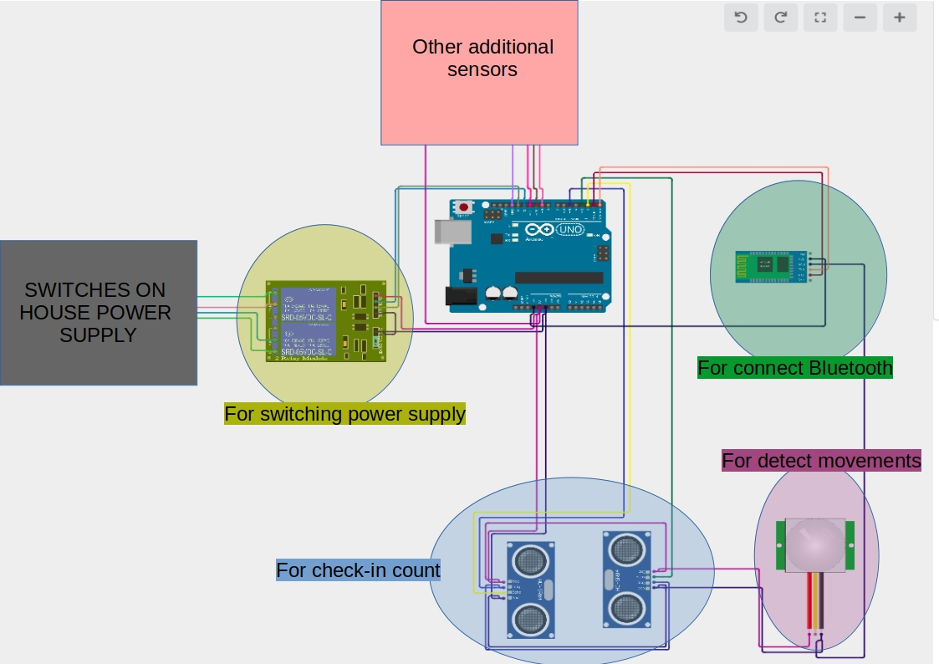
(PIR SENSOR)
(ULTRASONIC SENSOR)

Slide 5
PROBLEMS REGARDING THIS PROJECT
SOLUTION
Anyone can control the switches if we don’t change the password.
Change the default password of module.

Slide 6

BUT
DON’T
TOUCH

